Slide 1
WELCOME TO OUR CLASS TODAY
English 6
REVIEW 4 LESSON 2: SKILLS

Slide 2
REVIEW 4 LESSON 2: SKILLS
A
B
C
D

Slide 3
REVIEW 4 LESSON 2: SKILLS

Slide 4
REVIEW 4 LESSON 2: SKILLS
A
B
A
A

Slide 5
REVIEW 4 LESSON 2: SKILLS

Slide 6
REVIEW 4 LESSON 2: SKILLS

Slide 7
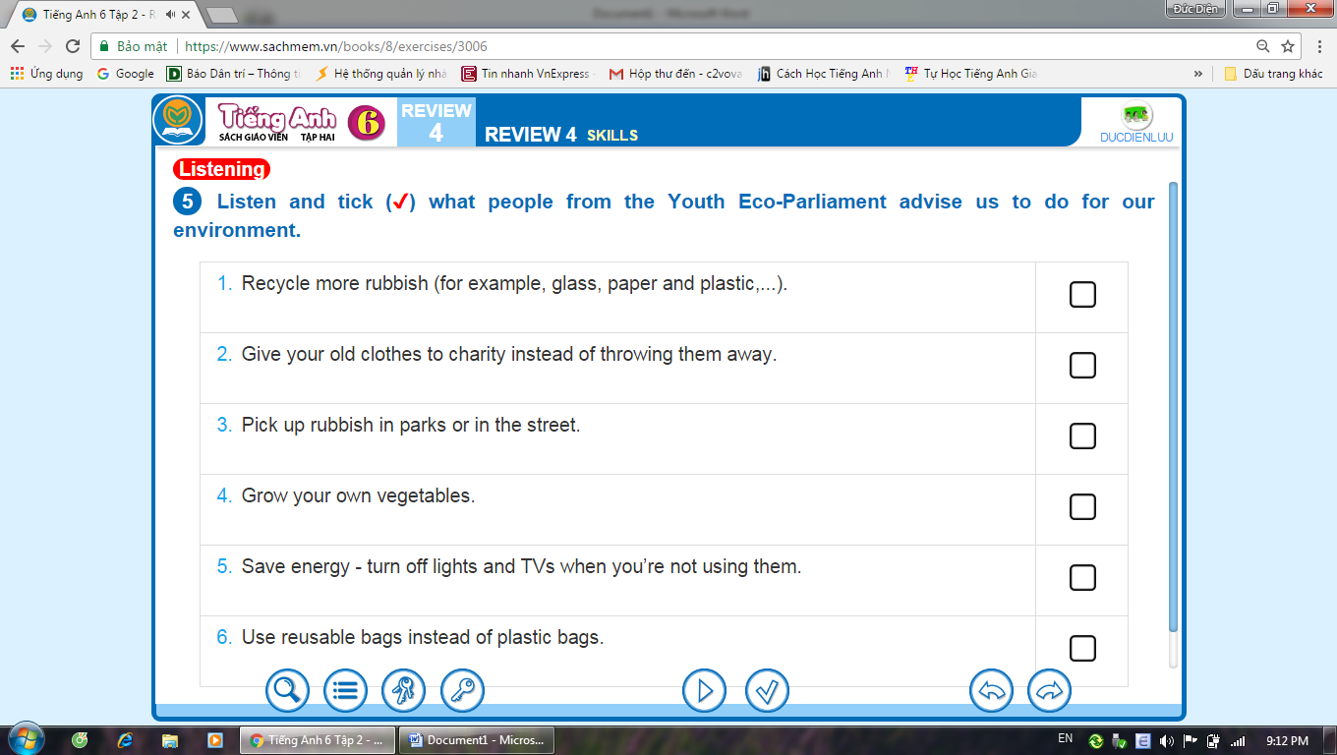
REVIEW 4 LESSON 2: SKILLS

Slide 8
REVIEW 4 LESSON 2: SKILLS

Slide 9
REVIEW 4 LESSON 2: SKILLS
Homework
Prepare for THE SECOND SEMESTER

